Slide 1
FrontEnd Backend Communication
Angular Admin with Java Backend

Slide 2
Implement HTTP Client for Angular Web Admin
Notes:
Let us now make front end communicate with backend using http client in Angular.
We will begin with Angular Admin Project which involves login flow, managing products, users, orders etc

Slide 3





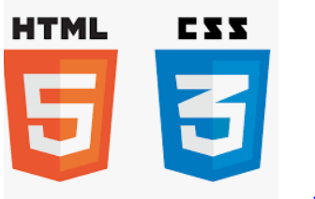

Before we begin, let’s recall what we have covered till now:
Agile
Git
SQL
Angular
HTML
CSS
JavaScript
CoreJava

Slide 4





Before we begin, let’s recall what we have covered till now:
JDBC
JSP
Servlets
MongoDB
Maven

Slide 5





Before we begin, let’s recall what we have covered till now:
JUnit
Spring
Spring Boot
Webservices
MicroServices

Slide 6
Create Angular Apps
Develop the front end using Angular
Create Admin and End User Projects
Create Spring Boot Java Backend
Create and setup a Spring Boot Project
Configure the dependencies for Web and DB
Configure Server and DB Details
Configure Apache Tomcat Server
Configure database properties in Java Backend Project
Create Microservices
Create microservices in Java Backend Project
Connect with MySQL Database

Slide 7
As a full stack web developer, our key role is to develop both client and server software.
Angular and Node can be used to build front end of the web page.
Spring Boot, Java, and MySQL/MongoDB can be used to build at the back end.

Slide 8

Now, Bob needs to develop Angular Admin with Java Backend. So, Bob brainstorms a bit and finds a solution.
Let me use my skills in JavaScript, Angular, Spring, Spring Boot, Web Services and MicroServices and make the front end communicate with the backend.
In this lesson, we will use HttpClientModule in our Angular project and send the Request to the Services in the backend and process the response and help Bob to complete his task effectively and quickly.

Slide 9

Build Front End and Back End Communication
Implement the HTTP Request Response flow
Use HttpClientModule in Angular
Validate the Login Flows and Database with data

Slide 10
Implement HttpClient in Angular Components
Notes:
Let us now, implement HttpClient API in Angular to perform Request Response over HTTP to various backend services.

Slide 11
Add the HTTPClientModule in app.module.ts
In the app.module.ts, add the HttpClientModule from Angular common HTTP.
import { HttpClientModule } from '@angular/common/http';
@NgModule({
declarations: [
AppComponent,
//…
],
imports: [
BrowserModule,
BrowserAnimationsModule,
AppRoutingModule,
NgbModule,
HttpClientModule,
],
bootstrap: [AppComponent]
})
export class AppModule { }
Notes:
In the app.module.ts, add the HttpClientModule from angular common http

Slide 12
Define the End Points for the Services in Backend
Create a new class BaseUrls to define all the End Points for the various services in the backend.
export class BaseUrls {
public static readonly BASE_HREF: string = "http://localhost:8080";
public static readonly ADMIN_GROUPURL: string = "adminauth";
public static readonly USER_GROUPURL: string = "users";
public static readonly SHIPMENT_GROUPURL: string = "shipments";
public static readonly PRODUCT_GROUPURL: string = "products";
public static readonly ORDER_GROUPURL: string = "orders";
public static readonly ORDER_ITEMS_GROUPURL: string = "orderitems";
public static readonly CATEGORIES_GROUPURL: string = "categories";
public static readonly CART_GROUPURL: string = "cart";
public static readonly WISHLIST_GROUPURL: string = "wishlist";
localhost:8080 is where our java backend will be running, and hence, the BASE URL is defined with the value http://localhost:8080.
Notes:
Create a new class BaseUrls where we can define all the End Points for the various services in the backend.
localhost:8080 is where our java backend will be running and hence the BASE URL is defined with value http://localhost:8080.

Slide 13
Define the End Points for the Services in Backend
Use port number as per the application.properties server port in your Java backend.
For the application to go live, change this base URL as per production server details where Java backend is hosted and ran.
public static getUrl(key: string): string { return `${this.BASE_HREF}/${key}/get`;}
public static getAddUrl(key: string): string { return `${this.BASE_HREF}/${key}/add`;}
public static getUpdateUrl(key: string): string { return `${this.BASE_HREF}/${key}/update`;}
public static getDeleteUrl(key: string): string { return `${this.BASE_HREF}/${key}/delete`;}
public static getLoginUrl(key: string): string { return `${this.BASE_HREF}/${key}/login`;}
}
Notes:
You may use the port number as per the application.properties server port in your java backend.
Further, when we need to make the application go live, we must change this base url as per our production server details where java backend is hosted and running

Slide 14
Auth Component For Admin Login
For Admin Authentication, a login component was created, which reads the form data entered by the Admin User in Form.
loginUser(value: {email: string; password: string}) {
const formData = new FormData();
formData.append("email", value.email.trim() || "");
formData.append("password", value.password.trim() || "");
this.http.post(BaseUrls.getLoginUrl(BaseUrls.ADMIN_GROUPURL), formData)
.subscribe({
Notes:
For Admin Authentication we created a login component which reads the form data entered by the Admin User in Form.

Slide 15
Auth Component For Admin Login
The login component uses AuthService, where the authentication is done using the loginUser method.
next: ({ code, message, data }: any) => {
localStorage.setItem("authCode", code);
this.router.navigate(['/'], { replaceUrl: true })
this.toast.success(message, "Login Successful");
},
error: (error) => {
localStorage.setItem("authCode", "");
this.toast.warning("Please Check Your Credentials", "");
}
})
}
Notes:
The login component uses AuthService, where the authentication is done using the loginUser method.

Slide 16
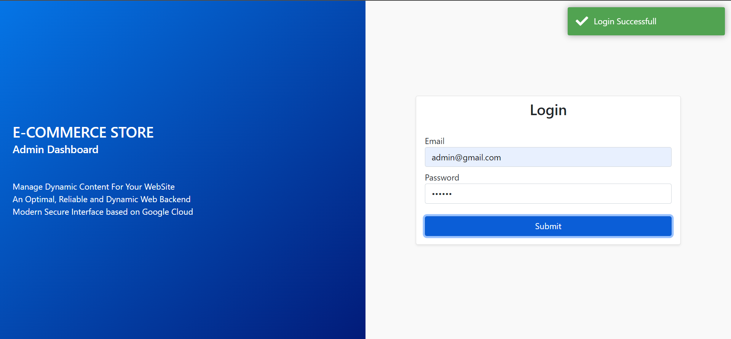
Auth Component For Admin Login: Success
Once API Sends response for success, show a toast message.
Notes:
Once, the API Sends response for success we will show a Toast message.

Slide 17
DB Service
In an Angular project, DB Service will request the Java Backend to fetch data for various modules in our project.
export class DbService {
//…
constructor(
private httpClient: HttpClient
) { }
getUsers(){
//…
}
getProducts(){
//…
}
//…
}
Notes:
In Angular project, we will have a DBService which will request the Java Backend to fetch data for various modules in our project

Slide 18
DB Service: getUsers
DB Service getUsers method performs HTTP Client Request to User Service Endpoint in the Java Backend to fetch all users.
export class DbService {
//…
constructor(
private httpClient: HttpClient
) { }
//…
Notes:
DB Service getUsers method performs HTTP Client Request to User Service Endpoint in the Java Backend to fetch all Users

Slide 19
DB Service: getUsers
getUsers() {
this.httpClient.get(BaseUrls.getUrl(BaseUrls.USER_GROUPURL))
.subscribe({
next: ({code, data, message}: any) => {
this.users.next(data);
this.usersRetreivedBool = true;
},
error: (error) => {
console.log(error);
}
})
}
}

Slide 20
UsersComponent: getUsers Using DBService
Users Component shall use the DB Service getUsers method to display all the users to the admin dashboard.
export class UsersComponent implements OnInit {
// usersObservable = new Observable<any[]>();
users: Users[] = [];
constructor(
// private httpClient: HttpClient
private db: DbService
) { }
Notes:
Users Component shall use the DB Service getUsers method to display all the users to the admin dashboard

Slide 21
UsersComponent: getUsers Using DBService
ngOnInit(): void {
this.db.getUsers();
this.db.users.subscribe((list) => {
if(list.length !== 0) this.users = list;
})
// this.usersObservable = this.httpClient.get<any[]>("./../../assets/json/users.json");
}
}

Slide 22
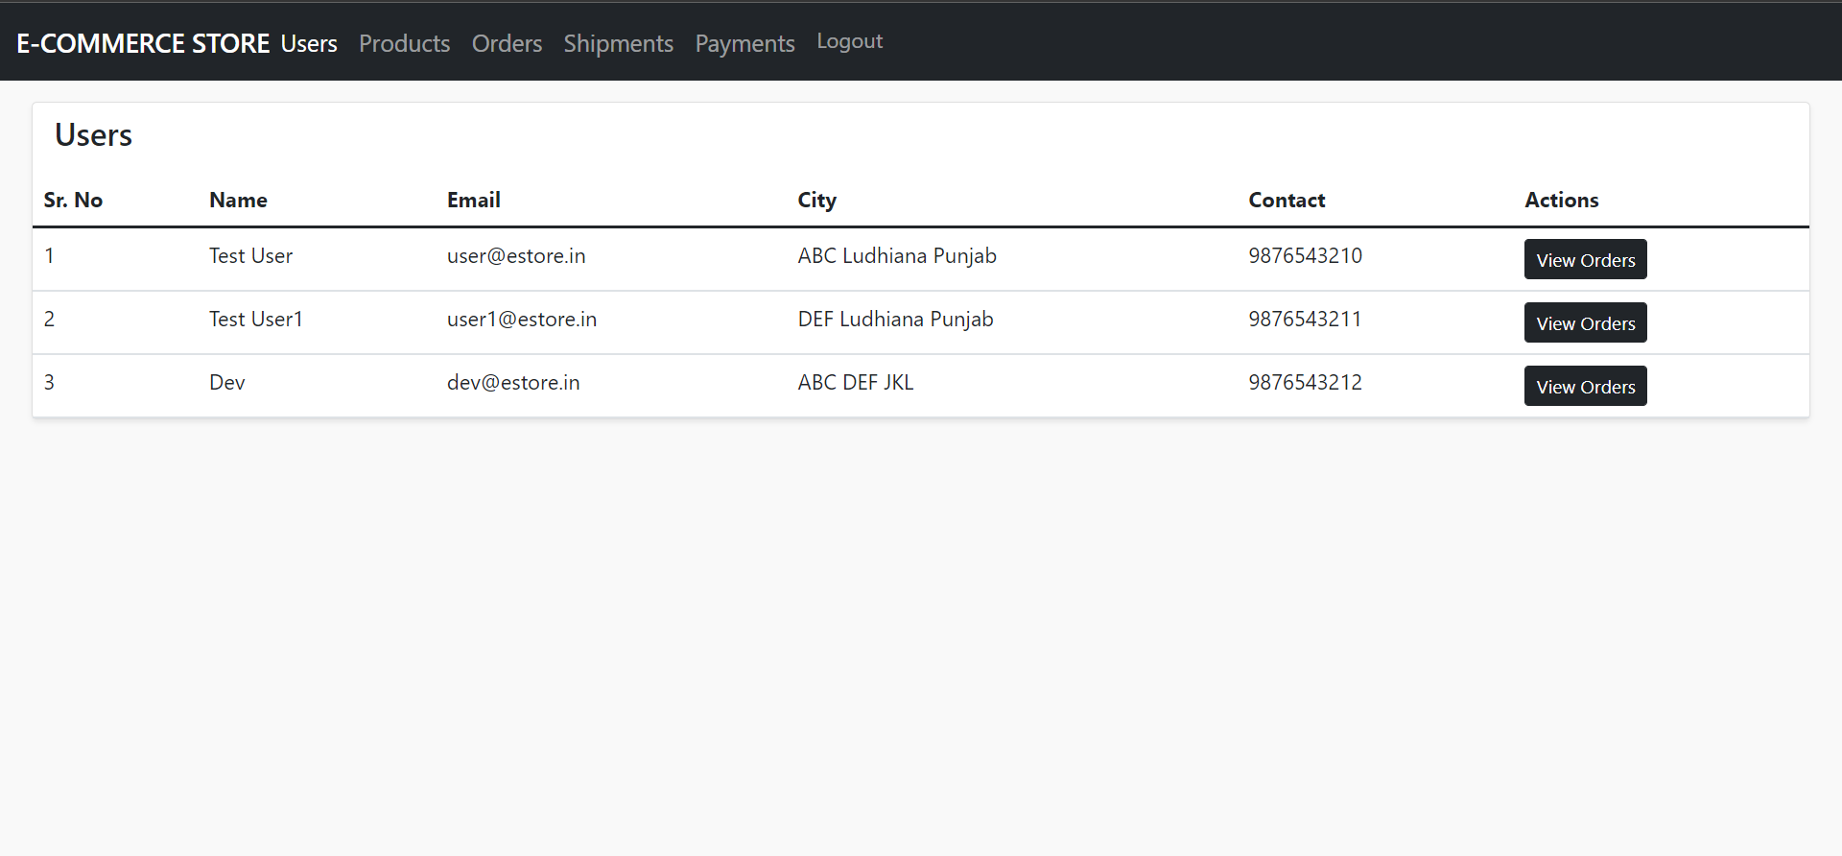
UsersComponent: Listing Users on UI
Component displays the list of users on the UI using DB Service getUsers method, which internally makes Java backend HTTP Request.
Notes:
Component displays the list of users on the UI using DB Service getUsers method, which internally makes Java backend HTTP Request

Slide 23
UsersComponent: Listing Users on UI
A snippet of HTML template of the component:
<tbody>
<tr *ngFor="let prod of products; index as idx">
<td>{{ idx + 1 }}</td>
<td>{{ prod["productCode"] }}</td>
<td class="text-wrap">{{ prod["productTitle"] }}</td>
<td class="text-wrap">{{ prod["productDescription"] }}</td>
<!-- <td>{{ prod["productCategory"]["categoryName"] }}</td> -->
<td>{{ prod["price"] | currency:'INR':'symbol' }}</td>
<td>
Notes:
Snippet for HTML template of the component:
<tbody>
<tr *ngFor="let prod of products; index as idx">
<td>{{ idx + 1 }}</td>
<td>{{ prod["productCode"] }}</td>
<td class="text-wrap">{{ prod["productTitle"] }}</td>
<td class="text-wrap">{{ prod["productDescription"] }}</td>
<!-- <td>{{ prod["productCategory"]["categoryName"] }}</td> -->
<td>{{ prod["price"] | currency:'INR':'symbol' }}</td>
<td>

Slide 24
UsersComponent: Listing Users on UI
<button type="button" class="btn btn-sm btn-dark me-1" (click)="openImageModal(viewImageModal, prod['images'], prod.thumbnailImage)">View Images</button>
<button type="button" class="btn btn-sm btn-dark me-1" (click)="viewProductDetails(viewModal, prod)">View Details</button>
<button type="button" class="btn btn-sm btn-dark me-1" (click)="openModal(productModal, prod)">Update</button>
<button type="button" class="btn btn-sm btn-danger me-1" (click)="deleteProducts(prod['productId'], idx)">Delete</button>
</td>
</tr>
</tbody>
Notes:
<button type="button" class="btn btn-sm btn-dark me-1" (click)="openImageModal(viewImageModal, prod['images'], prod.thumbnailImage)">View Images</button>
<button type="button" class="btn btn-sm btn-dark me-1" (click)="viewProductDetails(viewModal, prod)">View Details</button>
<button type="button" class="btn btn-sm btn-dark me-1" (click)="openModal(productModal, prod)">Update</button>
<button type="button" class="btn btn-sm btn-danger me-1" (click)="deleteProducts(prod['productId'], idx)">Delete</button>
</td>
</tr>
</tbody>

Slide 25
DB Service: getProducts
DB Service getProducts method performs HTTP Client Request to Product Service Endpoint in the Java Backend to fetch all products.
export class DbService {
//…
constructor(
private httpClient: HttpClient
) { }
//…
Notes:
DB Service getProducts method performs HTTP Client Request to Product Service Endpoint in the Java Backend to fetch all Products

Slide 26
DB Service: getProducts
getProducts() {
this.httpClient.get(BaseUrls.getUrl(BaseUrls.PRODUCT_GROUPURL))
.subscribe({
next: ({code, data, message}: any) => {
this.products.next(data);
this.productsRetreivedBool = true;
},
error: (error) => {
console.log(error);
}
})
}
}

Slide 27
ProductsComponent: getProducts and getCategories Using DBService
Products Component shall use the DB Service getProducts and getCategories method to display all the products along with categories to the admin dashboard.
export class ProductsComponent implements OnInit {
// usersObservable = new Observable<any[]>();
users: Users[] = [];
constructor(
// private httpClient: HttpClient
private db: DbService
) { }
Notes:
Products Component shall use the DB Service getProducts and getCategories method to display all the products alongwith categories to the admin dashboard

Slide 28
ProductsComponent: getProducts and getCategories Using DBService
Admin can use other methods to save a product and delete a product that interacts with Java Backend Service.
ngOnInit(): void {
this.db.getProducts();
this.db.getCategories();
combineLatest([this.db.products, this.db.categoies])
.subscribe(([products, categories]) => {
if(products.length !== 0) this.products = products;
if(categories.length !== 0) this.categories = categories;
});
}
}
Notes:
Admin can use other methods to save a product and delete a product which interacts with Java Backend Service

Slide 29
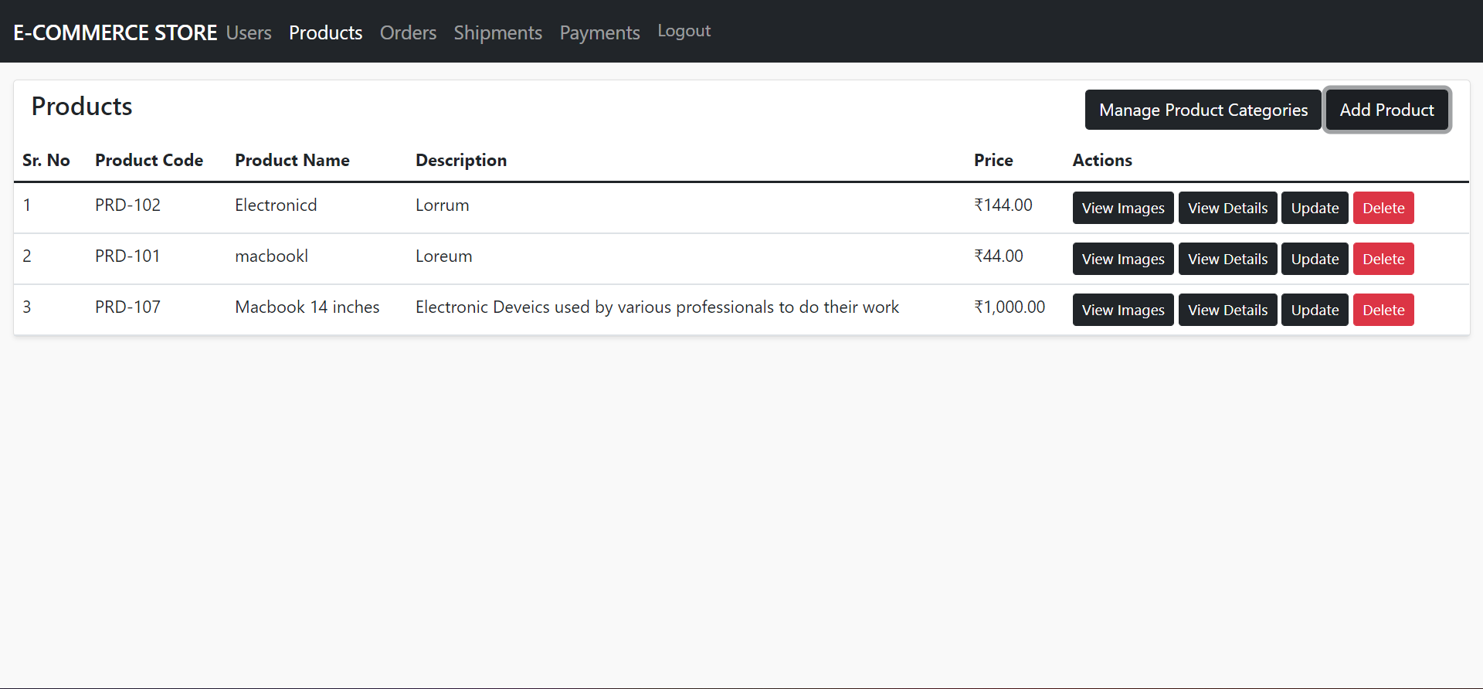
ProductsComponent: Listing Products on UI
Component displays the list of products on the UI using DB Service getProducts method, which internally makes Java backend HTTP Request.
Notes:
Component displays the list of products on the UI using DB Service getProducts method, which internally makes Java backend HTTP Request

Slide 30
ProductsComponent: Listing Products on UI
A snippet of the HTML template for the component:
<tbody>
<tr *ngFor="let user of users; index as idx">
<td>{{ idx + 1 }}</td>
<td>{{ user["fullName"] }}</td>
<td>{{ user["email"] }}</td>
<td>{{ user["street"] + " " + user["city"] + " " + user['state'] }}</td>
<td>{{ user["contact"] }}</td>
<td>
<button type="button" class="btn btn-sm btn-dark">View Orders</button>
</td>
</tr>
</tbody>
Notes:
Snippet for HTML template of the component:
<tbody>
<tr *ngFor="let user of users; index as idx">
<td>{{ idx + 1 }}</td>
<td>{{ user["fullName"] }}</td>
<td>{{ user["email"] }}</td>
<td>{{ user["street"] + " " + user["city"] + " " + user['state'] }}</td>
<td>{{ user["contact"] }}</td>
<td>
<button type="button" class="btn btn-sm btn-dark">View Orders</button>
</td>
</tr>
</tbody>

Slide 31
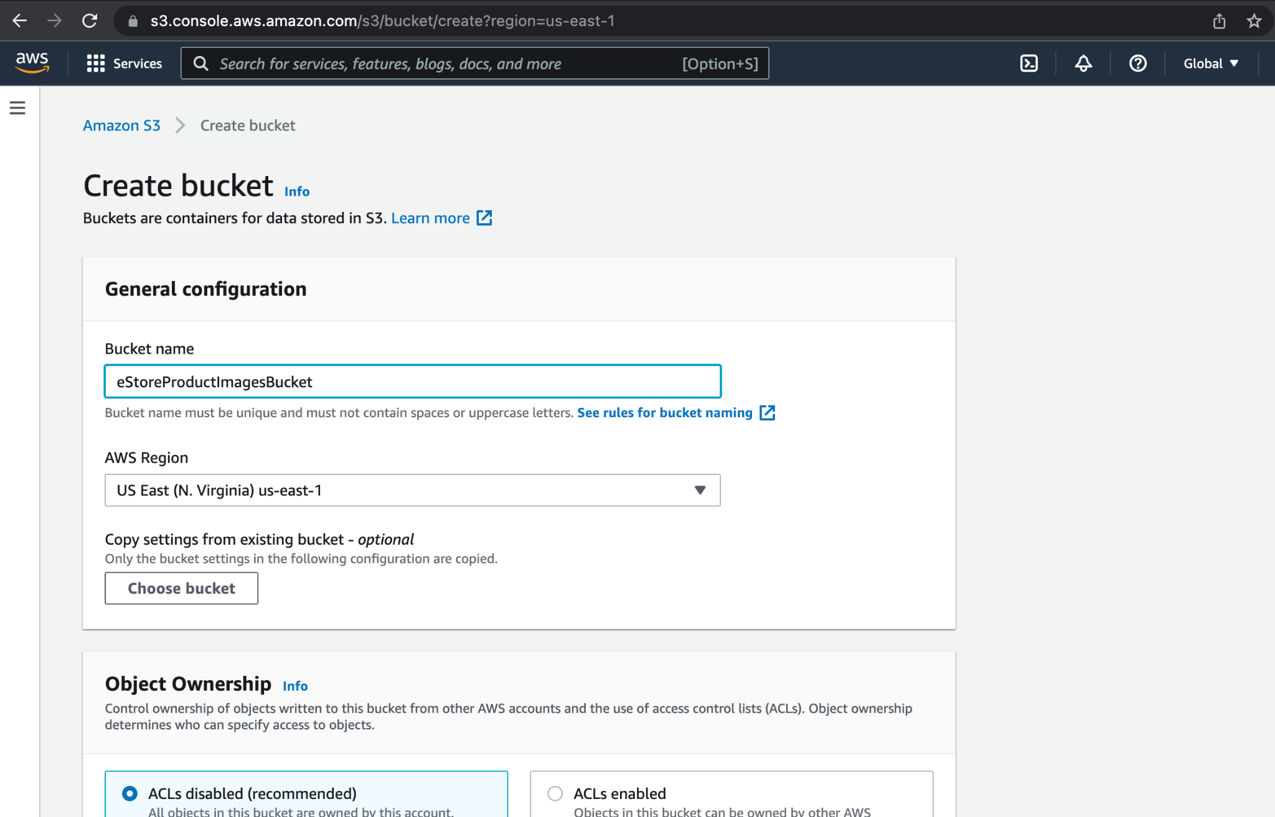
Products Component: Add Images Using AWS S3 Bucket
Use AWS S3 Buckets to upload images for the products.
Create S3 Storage bucket in cloud firstly.
Notes:
We will use AWS S3 Buckets to upload images for the products. You need to create S3 Storage bucket in cloud firstly.

Slide 32
Products Component: Add Images using AWS S3 Bucket
Next, integrate AWS SDK for Node to upload the images.
Command to add AWS SDK: npm i aws-sdk
Notes:
Next, you can integrate AWS SDK for Node to upload the images.
Command to add AWS SDK
npm i aws-sdk

Slide 33
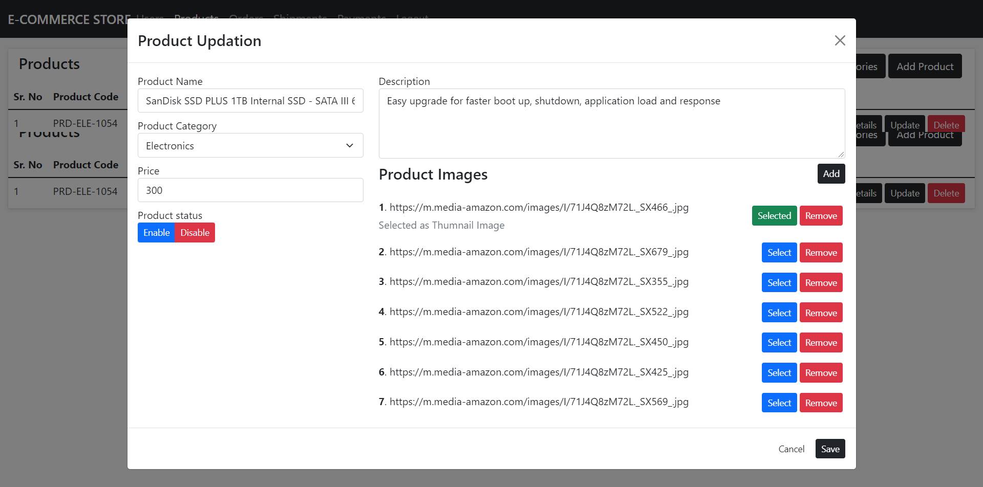
Products Component: Add Images using AWS S3 bucket
On the Products Component Web Page, an Action Button to add the product to the database.
Notes:
On the Products Component Web Page, we have an Action Button to add the product in the database.

Slide 34
Products Component: Add Images Using AWS S3 bucket
On clicking the Action Button, a modal opens, which typically is a UI in a dialog view.
Add the details of a product in a form.
Notes:
On click of it we will open a modal, which typically is a UI in a dialog view. Here we will add the details of a product in a form.

Slide 35
Products Component: Add Images Using AWS S3 bucket
Select the category from a dropdown to be linked to the product.
Notes:
Here we will also select the category from a dropdown to be linked to the Product.

Slide 36
Products Component: Add Images Using AWS S3 bucket
Associate the images that link to the product and the image as a thumbnail can be managed.
Notes:
We can associate as many as image we wish to link to the product and also the image which we wish to be shown as a thumbnail can be managed from here.

Slide 37
Products Component: Add Images Using AWS S3 bucket
openImageModal(modal: any, imageUrls: string[], thumbnailImageIdx: number) {
this.tempImageFiles = [...imageUrls];
this.thumbnailImageIdx = thumbnailImageIdx;
this.modalService.open(modal, {
size: "xl",
scrollable: true
});
}
Notes:
openImageModal(modal: any, imageUrls: string[], thumbnailImageIdx: number) {
this.tempImageFiles = [...imageUrls];
this.thumbnailImageIdx = thumbnailImageIdx;
this.modalService.open(modal, {
size: "xl",
scrollable: true
});
}

Slide 38
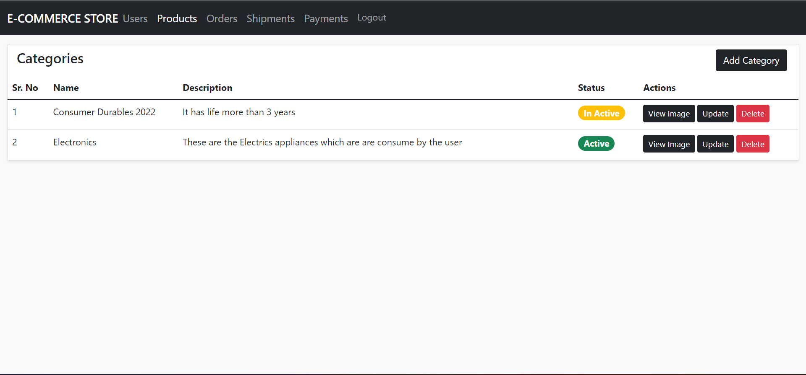
ProductsCategories: Listing Categories on UI
Component displays the list of product categories on the UI using DB Service getCategories method, which internally makes Java backend HTTP Request.
Notes:
Component displays the list of product categories on the UI using DB Service getCategories method, which internally makes Java backend HTTP Request
Snippet for HTML template of the component:
<tbody>
<tr *ngFor="let prod of categories; index as idx">
<td>{{ idx + 1 }}</td>
<td>{{ prod["categoryName"] }}</td>
<td class="text-wrap w-50">{{ prod["categoryDescription"] }}</td>
<td>
<h5><span class="badge rounded-pill {{ prod['active'] ? 'bg-success' : 'bg-warning' }}">{{ prod['active'] ? "Active" : "In Active" }}</span></h5>
</td>
<td>
<button type="button" class="btn btn-sm btn-dark me-1 mb-1" [disabled]="prod['categoryImageUrl'] === ''">View Image</button>
<button type="button" class="btn btn-sm btn-dark me-1 mb-1" (click)="openProductCategoryDialog(prodCategoryModal, prod)">Update</button>
<button type="button" class="btn btn-sm btn-danger me-1 mb-1" (click)="deleteCategory(prod['categoryId'], idx)">Delete</button>
</td>
</tr>
</tbody>

Slide 39
ProductsCategories: Listing Categories on UI
A snippet of the HTML template for the component:
<tbody>
<tr *ngFor="let prod of categories; index as idx">
<td>{{ idx + 1 }}</td>
<td>{{ prod["categoryName"] }}</td>
<td class="text-wrap w-50">{{ prod["categoryDescription"] }}</td>
<td>
<h5><span class="badge rounded-pill {{ prod['active'] ? 'bg-success' : 'bg-warning' }}">{{ prod['active'] ? "Active" : "In Active" }}</span></h5>
</td>
Notes:
Component displays the list of product categories on the UI using DB Service getCategories method, which internally makes Java backend HTTP Request
Snippet for HTML template of the component:
<tbody>
<tr *ngFor="let prod of categories; index as idx">
<td>{{ idx + 1 }}</td>
<td>{{ prod["categoryName"] }}</td>
<td class="text-wrap w-50">{{ prod["categoryDescription"] }}</td>
<td>
<h5><span class="badge rounded-pill {{ prod['active'] ? 'bg-success' : 'bg-warning' }}">{{ prod['active'] ? "Active" : "In Active" }}</span></h5>
</td>

Slide 40
ProductsCategories: Listing Categories on UI
<td>
<button type="button" class="btn btn-sm btn-dark me-1 mb-1" [disabled]="prod['categoryImageUrl'] === ''">View Image</button>
<button type="button" class="btn btn-sm btn-dark me-1 mb-1" (click)="openProductCategoryDialog(prodCategoryModal, prod)">Update</button>
<button type="button" class="btn btn-sm btn-danger me-1 mb-1" (click)="deleteCategory(prod['categoryId'], idx)">Delete</button>
</td>
</tr>
</tbody>
Notes:
<td>
<button type="button" class="btn btn-sm btn-dark me-1 mb-1" [disabled]="prod['categoryImageUrl'] === ''">View Image</button>
<button type="button" class="btn btn-sm btn-dark me-1 mb-1" (click)="openProductCategoryDialog(prodCategoryModal, prod)">Update</button>
<button type="button" class="btn btn-sm btn-danger me-1 mb-1" (click)="deleteCategory(prod['categoryId'], idx)">Delete</button>
</td>
</tr>
</tbody>

Slide 41
OrdersComponent: getOrders
Orders Component shall use the getOrders method to display all the orders placed by users in admin dashboard.
export class OrdersComponent implements OnInit {
constructor(
private httpClient: HttpClient,
private toast: ToastrService,
private modalService: NgbModal
) { }
//….
getOrders(orderStatus: number = 0, orderStatusIdx: number = 0) {
this.httpClient.get<Response>(`${BaseUrls.BASE_HREF}/${BaseUrls.ORDER_GROUPURL}/get-orders/${orderStatus}`)
.subscribe({
next: ({ data }) => {
if(data.length !== 0) {
this.orderStatusIdx = orderStatusIdx;
this.orders = data;
Notes:
Orders Component shall use the getOrders method to display all the orders placed by users in admin dashboard

Slide 42
OrdersComponent: getOrders
Order has a state that the admin can update and implement the methods in the same component for the better management of the code.
} else {
this.toast.info("No Records Founds", "");
}
},
error: (error) => {
console.log(error);
this.toast.warning("Something went wrong!!", "Failed")
}
})
}
//…
}
Notes:
Since, the order has a state which admin can update, we will implement the methods in the same component for the better management of the code.

Slide 43
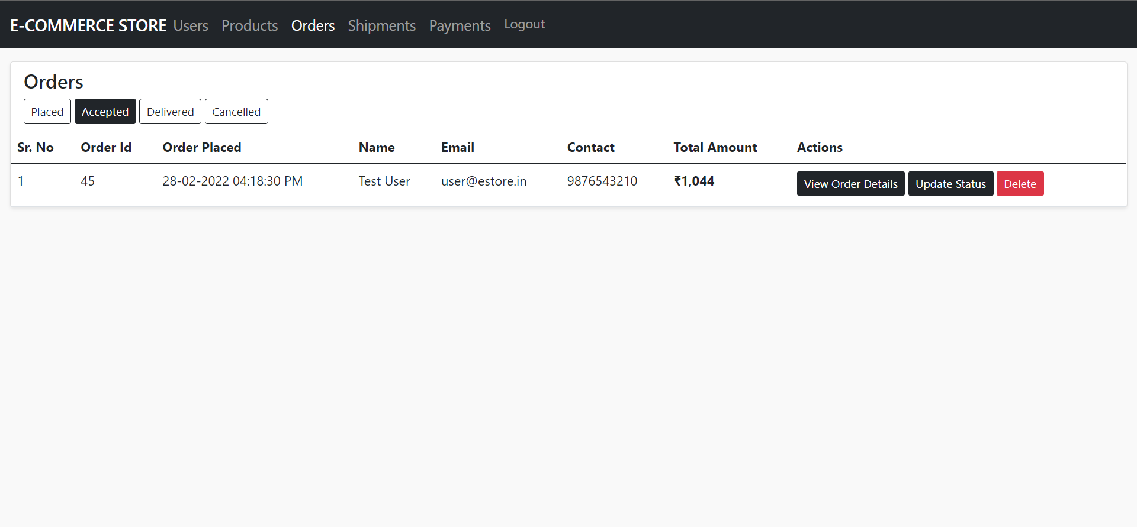
OrdersComponent: Listing Orders on UI
Component displays the list of orders on the UI using getOrders method, which internally makes Java backend HTTP Request.
Other options use the respective HTTP Requests to the Java backend. E.g.: Updating the status of the Order.
Notes:
Component displays the list of orders on the UI using getOrders method, which internally makes Java backend HTTP Request
Here, several other options uses the respective HTTP Requests to the Java backend eg: Updating the status of the Order

Slide 44
OrdersComponent: Listing Orders on UI
A snippet of the HTML template for the component:
<tbody>
<tr *ngFor="let prod of orders; index as idx" >
<td>{{ idx + 1 }}</td>
<td>{{ prod["orderId"] }}</td>
<td>{{ prod["orderDate"] | date: 'dd-MM-YYYY hh:mm:ss a' }}</td>
<td>{{ prod["name"] }}</td>
<td>{{ prod["email"] }}</td>
<td>{{ prod["contact"] }}</td>
<!-- <td>{{ prod["address"] }}</td> -->
<td><strong>{{ prod["totalAmount"] | currency:'INR':'symbol':'1.0' }}</strong></td>
Notes:
Snippet for HTML template of the component:
<tbody>
<tr *ngFor="let prod of orders; index as idx" >
<td>{{ idx + 1 }}</td>
<td>{{ prod["orderId"] }}</td>
<td>{{ prod["orderDate"] | date: 'dd-MM-YYYY hh:mm:ss a' }}</td>
<td>{{ prod["name"] }}</td>
<td>{{ prod["email"] }}</td>
<td>{{ prod["contact"] }}</td>
<!-- <td>{{ prod["address"] }}</td> -->
<td><strong>{{ prod["totalAmount"] | currency:'INR':'symbol':'1.0' }}</strong></td>

Slide 45
OrdersComponent: Listing Orders on UI
<td>
<button type="button" class="btn btn-sm btn-dark me-1 mb-1" (click)="openViewModal(prod, idx)">
View Order Details
</button>
<button type="button" class="btn btn-sm btn-dark me-1 mb-1" (click)="openOrderUpdateModal(orderStatusModel, prod)">Update Status</button>
<button type="button" class="btn btn-sm btn-danger me-1 mb-1">Delete</button>
</td>
</tr>
</tbody>
Notes:
<td>
<button type="button" class="btn btn-sm btn-dark me-1 mb-1" (click)="openViewModal(prod, idx)">
View Order Details
</button>
<button type="button" class="btn btn-sm btn-dark me-1 mb-1" (click)="openOrderUpdateModal(orderStatusModel, prod)">Update Status</button>
<button type="button" class="btn btn-sm btn-danger me-1 mb-1">Delete</button>
</td>
</tr>
</tbody>

Slide 46
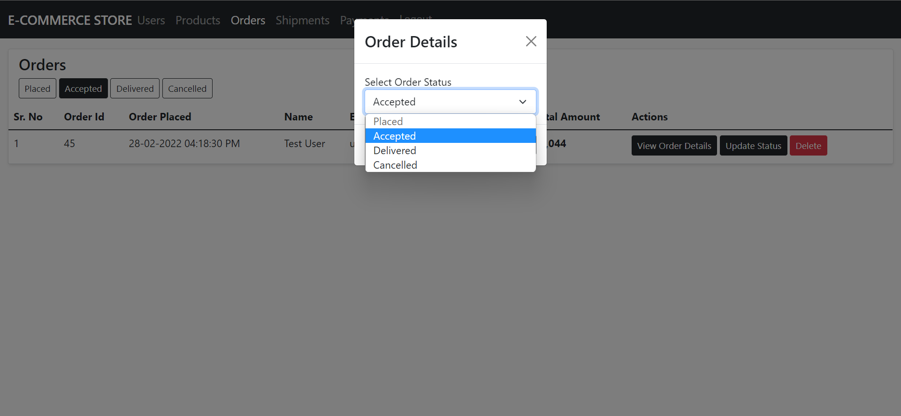
OrdersComponent: Update the State of Order
To update the state of an order, a separate Http Request is made to Java backend.
Notes:
To update the state of an order, a separate Http Request is made to java backend.

Slide 47
OrdersComponent: Update the State of Order
A snippet will make the updates:
this.httpClient.post<Response>(BaseUrls.getUpdateUrl(BaseUrls.ORDER_GROUPURL), getFormData(this.orderModel))
.subscribe({
next: ({ code, message, data }) => {
this.toast.success(message, "Success");
this.loader = false;
this.modalService.dismissAll();
},
error: (error) => {
this.loader = false;
console.log(error);
this.toast.warning("Something went wrong!!", "Failed")
}
})
Notes:
In orders component below snippet will make the updates:
this.httpClient.post<Response>(BaseUrls.getUpdateUrl(BaseUrls.ORDER_GROUPURL), getFormData(this.orderModel))
.subscribe({
next: ({ code, message, data }) => {
this.toast.success(message, "Success");
this.loader = false;
this.modalService.dismissAll();
},
error: (error) => {
this.loader = false;
console.log(error);
this.toast.warning("Something went wrong!!", "Failed")
}
})

Slide 48
PaymentsComponent: getPayments
Payments Component shall use the getPayment method to display all the payments in the admin dashboard for accounting purpose.
export class PaymentsComponent implements OnInit {
payments: any[] = [];
constructor(
private http: HttpClient,
private toast: ToastrService
) { }
ngOnInit(): void {
this.getPayments();
}
Notes:
Payments Component shall use the getPayment method to display all the payments in admin dashboard for accounting purpose

Slide 49
PaymentsComponent: getPayments
Implement the getPayments method in the same component for the better management of the code that performs the HTTP Client request to Java Backend.
getPayments() {
this.http.get<Response>(BaseUrls.getUrl(BaseUrls.ORDER_GROUPURL))
.subscribe({
next: ({ data }) => {
this.payments = data;
console.log(data);
},
error: (error) => {
console.log(error);
this.toast.warning("Something went wrong!!", "Failed")
}
})
}
}
Notes:
W will implement the getPayments method in the same component for the better management of the code which performs the HTTP Client request to Java Backend

Slide 50
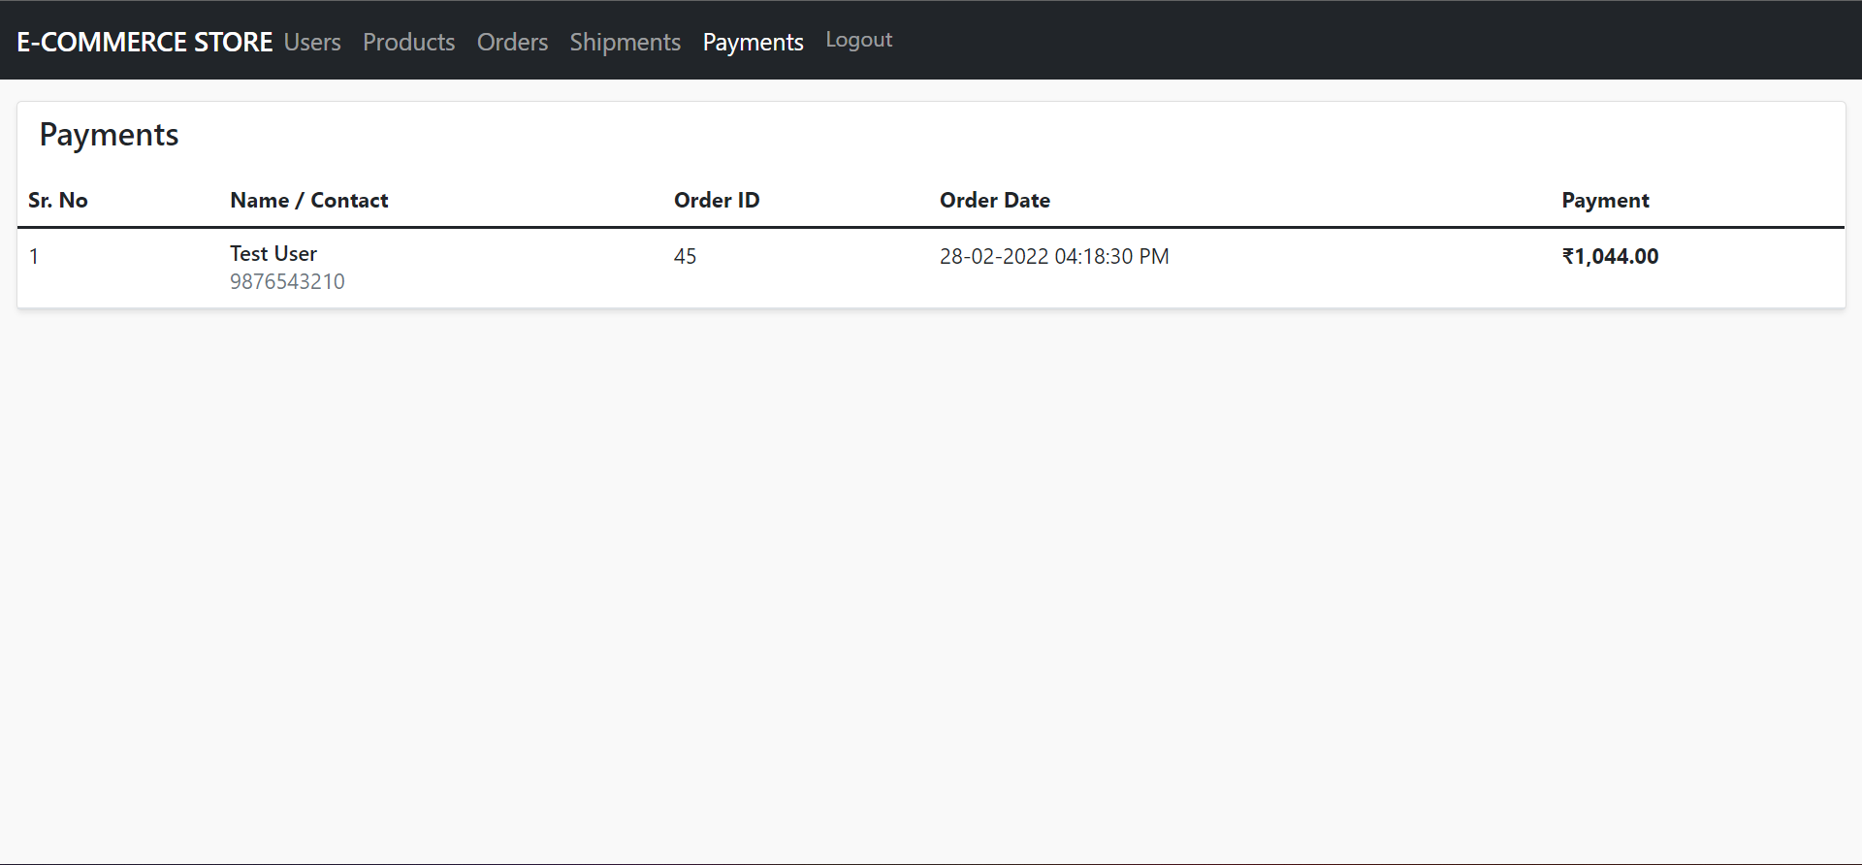
PaymentsComponent: Listing Payments on UI
Component displays the list of payments on the UI using getProducts method, which internally makes Java backend HTTP Request.
Notes:
Component displays the list of payments on the UI using getProducts method, which internally makes Java backend HTTP Request

Slide 51
PaymentsComponent: Listing Payments on UI
A snippet of the HTML template for the component:
<tbody>
<tr *ngFor="let payment of payments; index as idx">
<td>{{ idx + 1 }}</td>
<td>
<div class="d-flex flex-column">
<span class="h6 m-0">{{ payment.name }}</span>
<span class="text-sm text-muted">{{ payment.contact }}</span>
</div>
</td>
<td>{{ payment.orderId }}</td>
<td>{{ payment.orderDate | date: 'dd-MM-yyyy hh:mm:ss a' }}</td>
<td class="fw-bold">{{ payment.totalAmount | currency:'INR':'symbol' }}</td>
</tr>
</tbody>
Notes:
Snippet for HTML template of the component:
<tbody>
<tr *ngFor="let payment of payments; index as idx">
<td>{{ idx + 1 }}</td>
<td>
<div class="d-flex flex-column">
<span class="h6 m-0">{{ payment.name }}</span>
<span class="text-sm text-muted">{{ payment.contact }}</span>
</div>
</td>
<td>{{ payment.orderId }}</td>
<td>{{ payment.orderDate | date: 'dd-MM-yyyy hh:mm:ss a' }}</td>
<td class="fw-bold">{{ payment.totalAmount | currency:'INR':'symbol' }}</td>
</tr>
</tbody>

Slide 52
DB Service: getShipments
The DB Service getShipments method performs HTTP Client Request to shipments Service Endpoint in the Java Backend to fetch all shipments.
export class DbService {
//…
constructor(
private httpClient: HttpClient
) { }
//…
Notes:
DB Service getShipments method performs HTTP Client Request to Shipments Service Endpoint in the Java Backend to fetch all Shipments

Slide 53
DB Service: getShipments
getShipments(shipmentStatus: number = 0) {
this.httpClient.get<Response>(`${BaseUrls.getUrl(BaseUrls.SHIPMENT_GROUPURL)}/${shipmentStatus}`)
.subscribe({
next: ({ data }) => {
this.shipments.next(data);
this.shipmentRetreivedBool = true;
},
error: (error) => {
console.log(error);
}
})
}
}

Slide 54
ShipmentsComponent: getShipments Using DBService
Shipments Component shall use the DB Service getShipments method to display all the users on the admin dashboard.
export class ShipmentsComponent implements OnInit {
loader: boolean = false;
shipmentForm: FormGroup | any;
shipments: Shipments[] = [];
shipmentStatusIdx: number = 0;
shipmentStatus: { name: string; value: number }[] = [
{ name: 'Ready For Shipment', value: 0 },
{ name: 'In-Transit', value: 1 },
];
constructor(
private fb: FormBuilder,
public db: DbService,
private http: HttpClient,
private modalService: NgbModal,
private toast: ToastrService
) { }
Notes:
Shipments Component shall use the DB Service getShipments method to display all the users to the admin dashboard

Slide 55
ShipmentsComponent: getShipments Using DBService
Component will have other methods internally to perform other operations and update the state of shipment for an order.
ngOnInit(): void {
this.db.getShipments();
this.db.shipments.subscribe((list) =>{
if(list.length !== 0) {
this.shipments = list;
console.log(list);
}
})
}
//…
}
Notes:
The component will have other methods internally to perform other operations including update the state of shipment for an order.

Slide 56
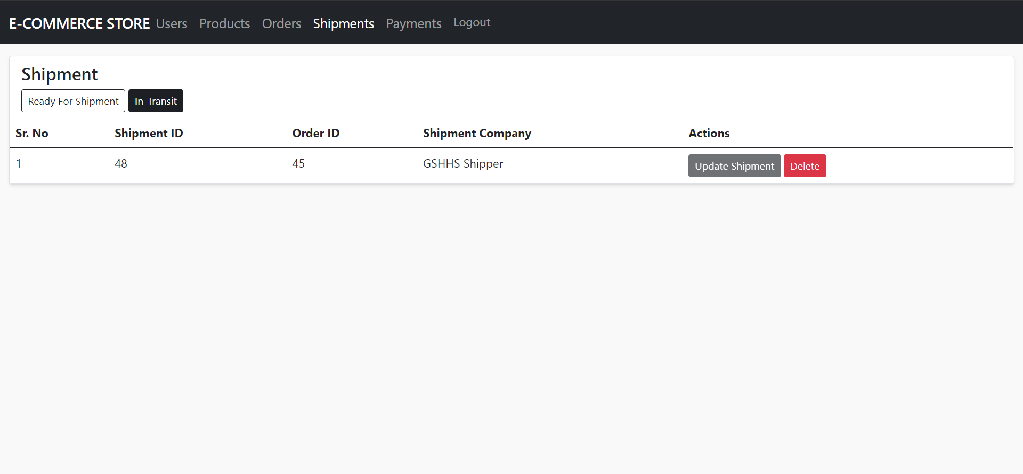
ShipmentsComponent: Listing Shipments on UI
Component displays the list of users on the UI using the DB Service getUsers method, which internally makes Java backend HTTP Request.
Notes:
Component displays the list of users on the UI using DB Service getUsers method, which internally makes Java backend HTTP Request

Slide 57
ShipmentsComponent: Listing Shipments on UI
A snippet of the HTML template for the component:
<tbody>
<tr *ngFor="let shipment of shipments; index as idx">
<td>{{ idx + 1 }}</td>
<td>{{ shipment?.shipmentId }}</td>
<td>{{ shipment.orderId }}</td>
<td>{{ shipment.shipmentCompany === "null" ? "Not Provided" : shipment.shipmentCompany }}</td>
<td>
<button type="button" class="btn btn-dark btn-sm me-1" [disabled]="shipment.shipmentStatus" (click)="openUpdateModal(shipmentModal, shipment)">Update Shipment</button>
<button type="button" class="btn btn-danger btn-sm" (click)="deleteShipment(shipment.shipmentId, idx)">Delete</button>
</td>
</tr>
</tbody>
Notes:
Snippet for HTML template of the component:
<tbody>
<tr *ngFor="let shipment of shipments; index as idx">
<td>{{ idx + 1 }}</td>
<td>{{ shipment?.shipmentId }}</td>
<td>{{ shipment.orderId }}</td>
<td>{{ shipment.shipmentCompany === "null" ? "Not Provided" : shipment.shipmentCompany }}</td>
<td>
<button type="button" class="btn btn-dark btn-sm me-1" [disabled]="shipment.shipmentStatus" (click)="openUpdateModal(shipmentModal, shipment)">Update Shipment</button>
<button type="button" class="btn btn-danger btn-sm" (click)="deleteShipment(shipment.shipmentId, idx)">Delete</button>
</td>
</tr>
</tbody>

Slide 58
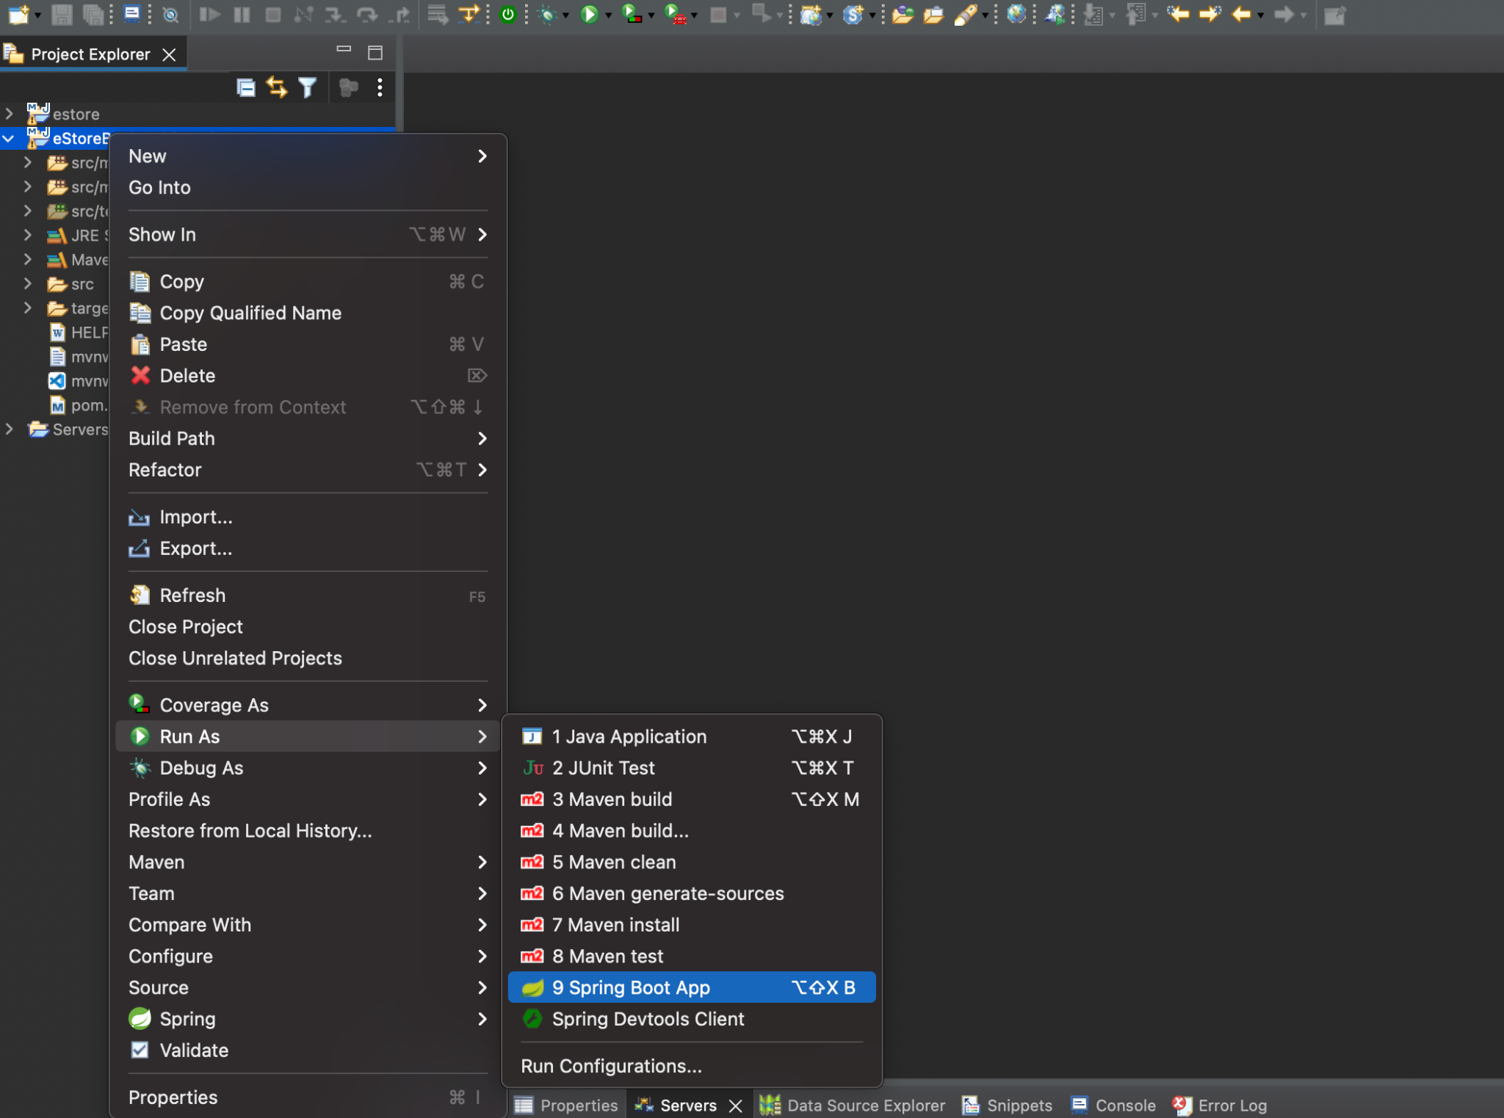
Run the Project as Spring Boot App
In order to make Angular App interact with Java Backend Services, the project needs to run.
right-click
right-click
Run as Spring Boot App.
or
Simply click the run icon and select run as spring boot app
Notes:
In order to make your Angular App interact with Java Backend Services, you need your project to be running.
Right click on the project and run as Spring Boot App
Or
Simply click the run icon and select run as spring boot app

Slide 59
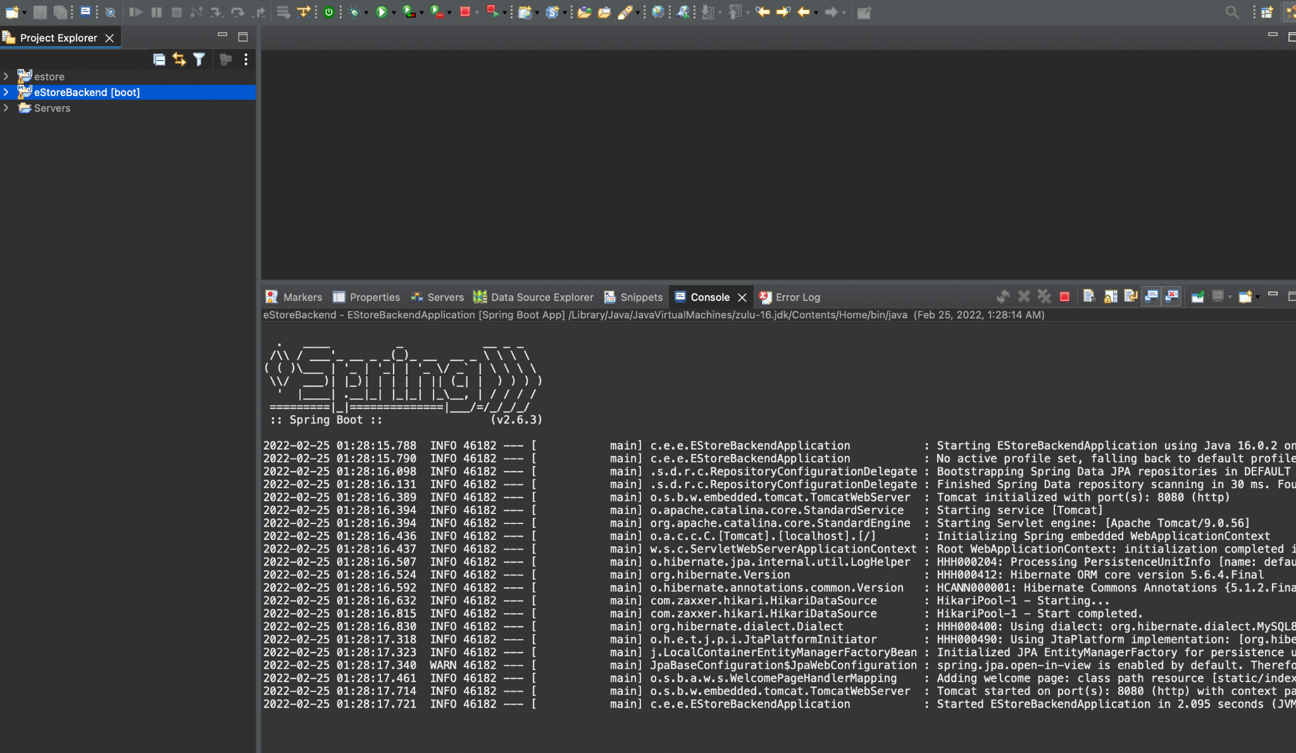
Project Run Output Logs
Check in the console if the application is running successfully on Tomcat Port 8080.
In case the 8080 port is blocked, go to application.properties file and change server port number.
Backend is up and run, serve angular app and test the communication.
Notes:
Check in the console if the application is running successfully on Tomcat Port 8080.
In case 8080 port is blocked, go to application.properties file and change the server port number
Once, the backend is up and running, you can serve your angular app and test the communication

Slide 60
HttpClient API is impletemented in Angular to perform Request Response over HTTP to various backend services.
Angular Components is made to send HTTP Client Request to Java Backend Services.
CRUD Operations is implemented in components using REST Architecture.
HTML templates is used to render the data fetched from Java Backend Service.

Slide 62
Which module will you import in app.module.ts to perform HTTP Requests from Angular App?
01
HttpAngular
HttpAngularModule
HttpClient
HttpClientModule

Slide 63
Which module will you import in app.module.ts to perform HTTP Requests from Angular App?
01
HttpAngular
HttpAngularModule
HttpClient
HttpClientModule
D
HttpClientModule has to be imported from @angular/common/http in order to use HTTPClient API.

Slide 64
How will you fetch response from the Server Using the HttpClient API in Angular?
02
using subscribe method
using listen method
using wait method
using open method

Slide 65
How will you fetch response from the Server Using the HttpClient API in Angular?
02
using subscribe method
using listen method
using wait method
using open method
A
You can execute subscribe method on the HttpClient get or post request to fetch response from the server.

Slide 66
Where will you store the images of the products?
03
AWS S3
AWS EC2
AWS Lambda
AWS MySQL

Slide 67
Where will you store the images of the products?
03
AWS S3
AWS EC2
AWS Lambda
AWS MySQL
A
In order to save images for the product, you must create a storage bucket in AWS S3 Service.

Slide 68
In order to delete a record based on id, select the correct URL pattern:
04
this.http.get<Response>(URL/${shipmentId})
this.http.get<Response>(URL)
this.http.get<Response>(${shipmentId}/URL)
None of the Above

Slide 69
In order to delete a record based on id, select the correct URL pattern:
04
this.http.get<Response>(URL/${shipmentId})
this.http.get<Response>(URL)
this.http.get<Response>(${shipmentId}/URL)
None of the Above
A
In order to delete a shipment based on shipment id, you shall use the snippet, this.http.get<Response>(`${BaseUrls.getDeleteUrl(BaseUrls.SHIPMENT_GROUPURL)}/${shipmentId}`)

Slide 70
How will you initialize HttpClient in your component?
05
Create its Object in Constructor definition
Create its object in ngOnInit
Using Dependency Injection technique in Constructor
All of the above

Slide 71
How will you initialize HttpClient in your component?
05
Create its object in constructor definition
Create its object in ngoninit
Using dependency injection technique in constructor
All of the above
C
You should perform dependency injection in constructor, eg: constructor( private http: HttpClient ) {}

Slide 72
Before the Next Class
You have successfully completed this session. Before the next discussion, you should go through:
Docker
Jenkins

Slide 73
What’s Next?
Now, we have finished our Classes and Design Pattern for the Backend Project wrt End Usermodule. In our next live session, we will :
See Front End and Back End Communication
See how to connect to MicroServices from Angular End User App
Explore HTTP Client Library for implementing REST Architecture
Complete both Admin and End User Projects with Backend Connectivity

